Slide 1
NULL SECTOR STUDIOS // GAMETECH TERM PROJECT
WARD 0
3D Deep Mine Quarantine & Diagnostic Psychological Horror
Hasan Can Zorlu • Hüseyin Köroğlu • Görkem Eren • Fikret Karakuzu

Slide 2
01 // TEAM INTRODUCTION & ARTISTIC ROLES
Who We Are: Null Sector Studios
[01] 3D CAMERAS
[02] CORE LOGIC
[03] 3D SCENE
[04] TECH ART
Hasan Can Zorlu
Hüseyin Köroğlu
Görkem Eren
Fikret Karakuzu
3D scanners, camera sway & visual occlusion.
Dual-source sanity & scripted FOV enemy logic.
Modular mine tunnels & corridor prefab swapping.
3D spatial audio & URP sanity post-processing.
X-Ray, CCTV & Occlusion
Sanity & FOV State Machine
Landmarks & Corridor Swap
Sanity Shaders & 3D Audio

Slide 3
02 // MOTIVATION & SEMESTER EXPECTATIONS
End-of-Semester Goal
Our Background & Course Goals
12-Week Semester Vision
•
First-Time Creators: Passionate horror fans inspired by Outlast & triage sims.
•
Zero Scope Creep: Armored checkpoint & task-specific modular mine tunnels.
•
Smart Asset Pipeline: Combining modular mine & bio-scanner packs with custom shaders.
•
No Fragile NavMesh: Scripted FOV encounters & steam-occluded corridor swapping.
•
Engineering Focus: Mastering Unity URP sanity post-processing & C# state machines.
•
Steam-Ready Release: Commercial polish built for viral streamer replayability.

Slide 4

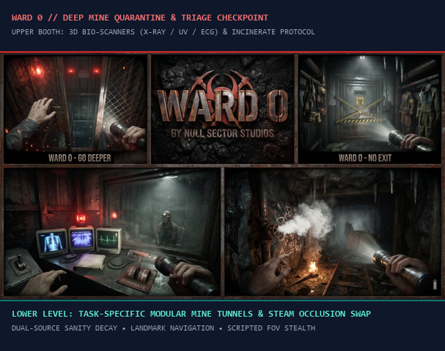
03 // GAME PITCH: CONCISE DESCRIPTION
What is WARD 0?
One reinforced glass window separates you from a neurotoxic mining nightmare.
Following a deep underground mine disaster and neurotoxic gas leak, evacuated miners arrive one by one inside the quarantine cell across from your armored checkpoint desk.
Using diegetic 3D scanners—and risky close-up blood draws—you must clear healthy workers or incinerate violent hosts. Clearing an infected miner is fatal; burning an innocent permanently drains sanity.

Slide 5
04 // CORE GAMEPLAY LOOP
Two-Tier Quarantine & Mine Protocol
STEP 01
STEP 02
STEP 03
STEP 04
3D Triage & Blood
Verdict & Sanity
Mine Maintenance
Landmarks & Stealth
Run X-Ray/UV/Thermal/ECG & enter cell for blood draws.
Clear or Incinerate: fatal ambush vs. permanent sanity loss.
Descend to fix valves; steam burst swaps rear corridors.
Follow landmarks back & hide from scripted FOV patrols.

Slide 6
05 // GAMEPLAY MECHANICS: SCANNERS & DUAL SANITY
3D Bio-Scanners & Sanity Thresholds
[SCANNER 01]
[SCANNER 02]
X-Ray & Thermal Scanners
UV Light & ECG Monitor
Exposes skeletal mutations & neurotoxic organ heat.
Reveals sub-dermal toxin veins & erratic heart spikes.
[MECHANIC 03]
[MECHANIC 04]
Close-Quarters Blood Draw
Dual Sanity & Thresholds
Step inside the cell for syringe samples & micro-jumpscares.
Guilt (permanent) + Gas (temporary) trigger sway & screams.

Slide 7
06 // TECHNICAL ARCHITECTURE IN UNITY URP
How We Build It
Rendering & Shader Pipeline
Deterministic C# Systems
•
Multi-Spectral Culling: Secondary cameras render skeletal & UV/Thermal layers to CRTs.
•
Occlusion Corridor Swap: Steam/spark blocks view while C# swaps rear tunnel prefabs.
•
Dual-Source Sanity: Permanent guilt loss + temporary gas decay cleared at booth.
•
Landmark Navigation: Memorize minecarts, chalk, torches & stalactites to return.
•
Threshold Effects: URP vignette, silhouettes, camera sway, heavy walk & 3D whispers.
•
Scripted FOV Stealth: No NavMesh; hosts spawn/despawn out of FOV while player hides.

Slide 8
07 // MARKET POTENTIAL & TARGET AUDIENCE
High-Return Indie Horror Niche
$9.3M+
Gross Steam revenue achieved by diagnostic horror hit The Mortuary Assistant—proving massive demand for visceral triage & Outlast-style tension.
18–34
908K+
Top 3
Core PC Horror Demographic
The Exit 8 Anomaly Copies Sold
Most Streamed Twitch Indie Genre

Slide 9
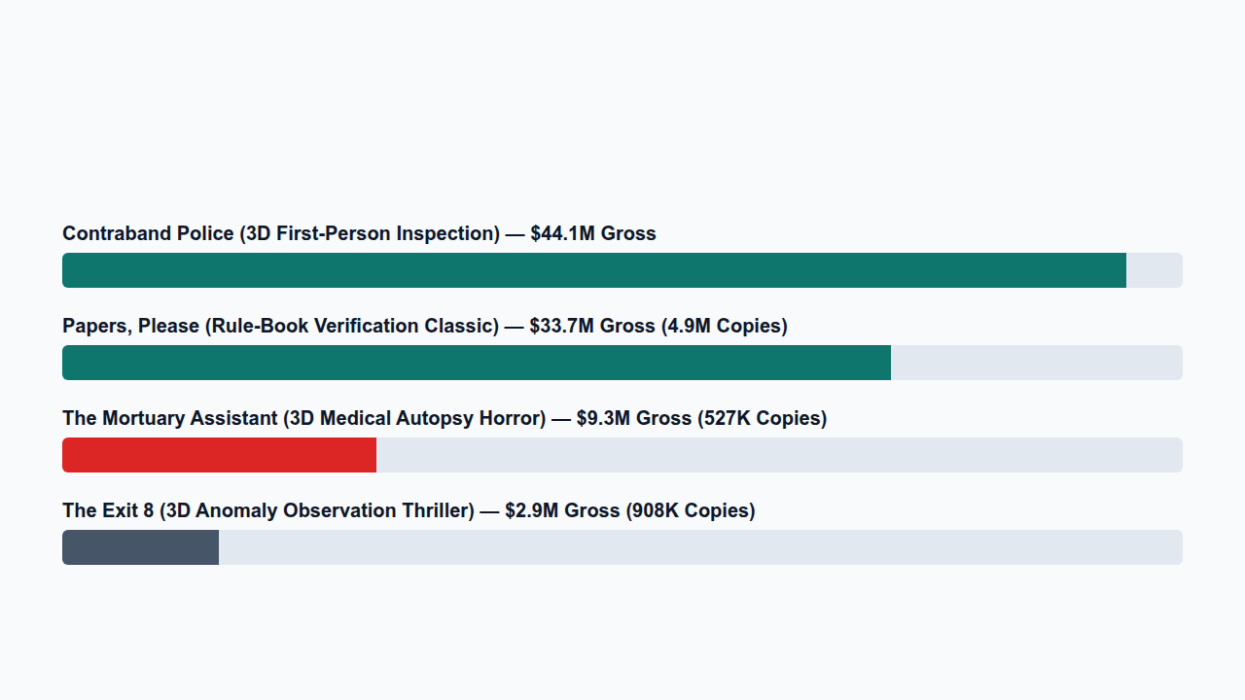
08 // FINANCIAL BENCHMARK OF SIMILAR GAMES
Steam Gross Revenue of 4 Reference Titles

Slide 10
09 // COMPETITIVE ANALYSIS (RUBRIC: 4+ SIMILAR GAMES)
Visual, Thematic & Mechanical Comparison
Game Title | Visual Perspective | Core Theme | Primary Mechanic | Steam & WARD 0 Edge
The Mortuary Assistant | 3D First-Person | Demonic Autopsy | Embalming & Sigil Match | $9.3M+ / Live Bio-Scanners
Papers, Please | 2D Pixel Booth | Border Checkpoint | Document Cross-Check | $33.7M+ / 3D Sanity Verdicts
Contraband Police | 3D First-Person | Smuggler Inspection | UV & Physical Search | $44.1M+ / Miner Blood Draws
The Exit 8 | 3D First-Person | Liminal Subway Loop | Visual Anomaly Spotting | $2.9M+ / Steam Corridor Swap
WARD 0 (Our Game) | 3D Mine & Booth | Mine Quarantine Horror | Triage, Sanity & Tunnel Swap | Landmarks + FOV Stealth

Slide 11
10 // INNOVATION & CREATIVITY
What Sets WARD 0 Apart?
01 // DUAL SANITY
02 // OCCLUSION SWAP
03 // FOV STEALTH
Permanent vs. Gas Decay
Non-Euclidean Tunnels
Deterministic Encounters
Burning innocents scars sanity forever; mine gas adds temporary decay.
Steam bursts mask C# corridor swaps; landmarks guide your return.
Zero NavMesh bugs: hide behind minecarts from scripted FOV patrols.

Slide 12
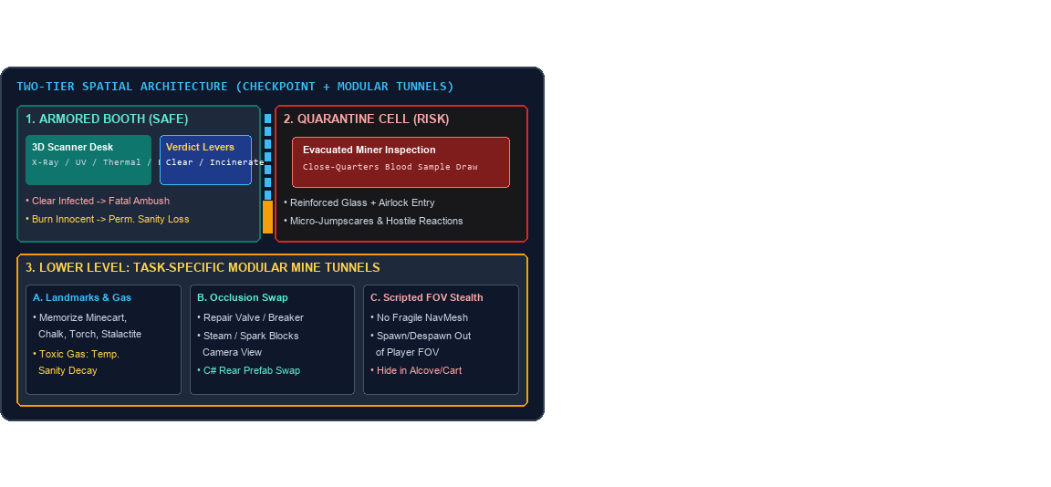
11 // PRE-PRODUCTION DRAFTS: 3D LEVEL & LOGO DESIGN
Ward 0 Spatial Blueprint & Visual Identity
Prototype & Asset Strategy
•
Logo Concept: Industrial mine stencil typography paired with a red biohazard icon.
•
Modular Mine Pack: Armored booth & task-specific tunnels with navigation landmarks.
•
Infected Miner Rigs: Outlast-inspired Mixamo rigs for blood draws & FOV patrols.
•
Diegetic & Sanity HUD: Physical CRT scanners + URP vignette, sway & 3D whispers.

Slide 13
12 // 12-WEEK WORK PLAN & GANTT SCHEDULE
Milestone Roadmap (WBS & Task Owners)
WBS | Milestone & Core Deliverables | Owner | W1–W2 | W3–W5 | W6–W9 | W10–W12
1.0 | Proposal, Mine Quarantine Concept, Assets & Greybox | All 4 Members | 100% Done | — | — | —
2.1 | Demo I: Armored Booth, Modular Mine Tunnels & Raycast | Hüseyin & Can | — | Active | — | —
2.2 | Demo I: CCTV, 3D Bio-Scanners & Cell Blood Draw | Görkem & Fikret | — | Active | — | —
3.1 | Demo II: Steam Corridor Swapping, Landmarks & FOV Stealth | Can & Görkem | — | — | Scheduled | —
3.2 | Demo II: Dual-Source Sanity, URP Shaders & 3D Audio | Hüseyin & Fikret | — | — | Scheduled | —
4.0 | Final Release: Shift Progression, Sanity QA & Trailer | All 4 Members | — | — | — | Final Launch

Slide 14
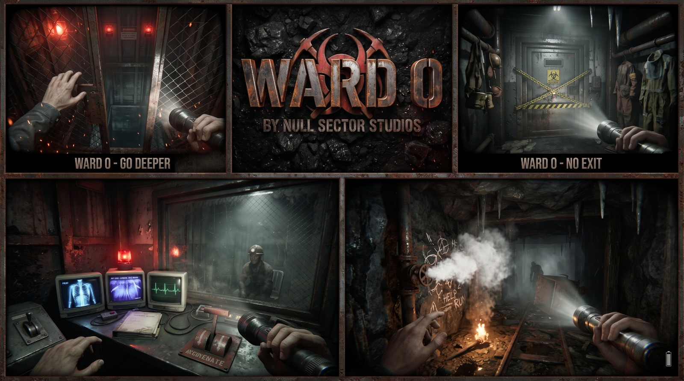
END OF BRIEFING // NULL SECTOR STUDIOS
Thank You & Q&A
Will you clear the miner, pull the incinerator lever, or lose your mind in the shifting tunnels below?

Slide 15
END OF BRIEFING // NULL SECTOR STUDIOS
Thank You & Q&A
Will you clear the miner, pull the incinerator lever, or lose your mind in the shifting tunnels below?

